Slide 1
Making a Video Game

Slide 2

You have an idea for a game.
But how do you create it?

Slide 3
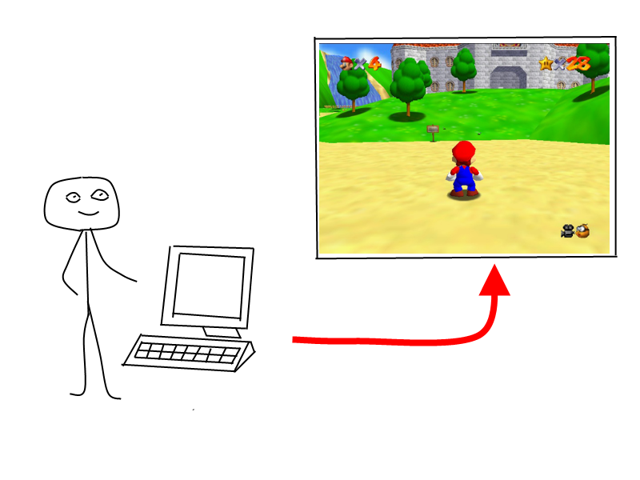
Learn to program a computer!
Notes:
Computers are everywhere. All of society runs on these things now.

Slide 4
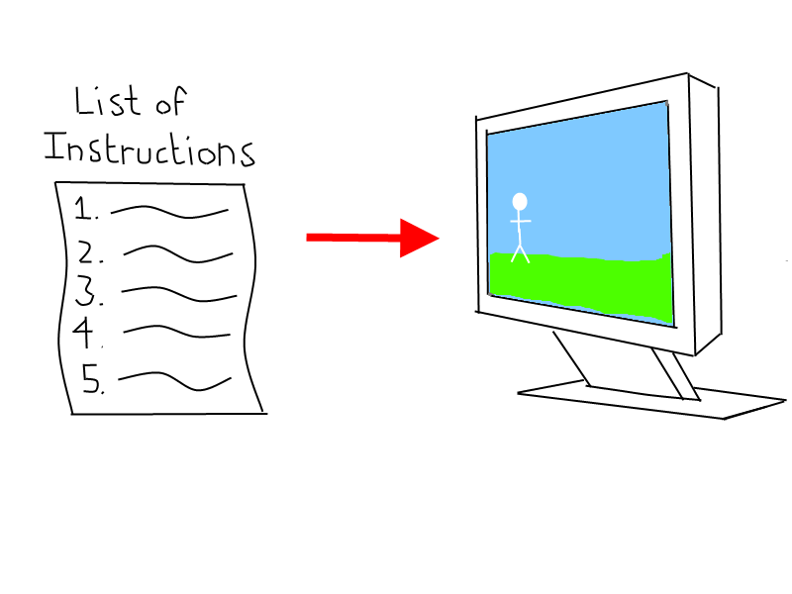
What do I do next?
Notes:
Programming means giving a computer a list of things to do in a language it understands. You have to tell the computer exactly what to do. You have to be very specific because computers are dumb. But they can follow instructions very quickly.

Slide 5
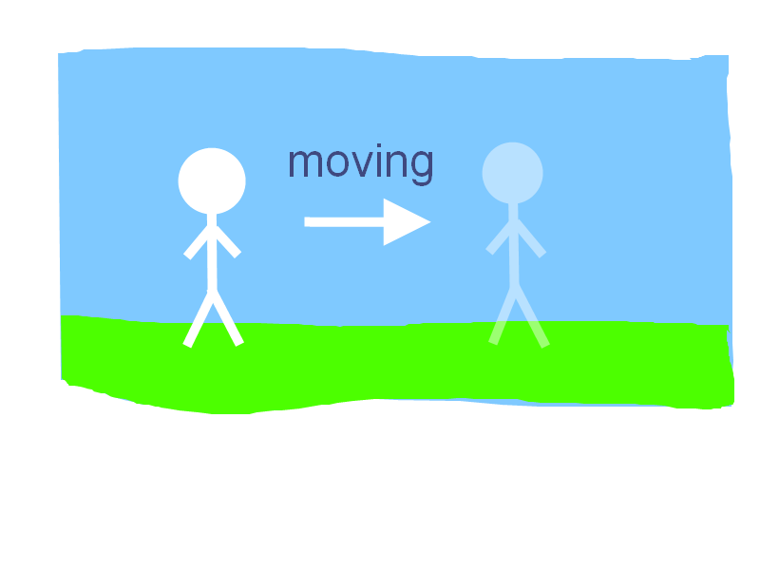
IF I press the Right Arrow Key,
THEN move the player to the right.
Notes:
Example instruction. Computers can read instructions like this. This is in plain English, but computers can’t read that.

Slide 6
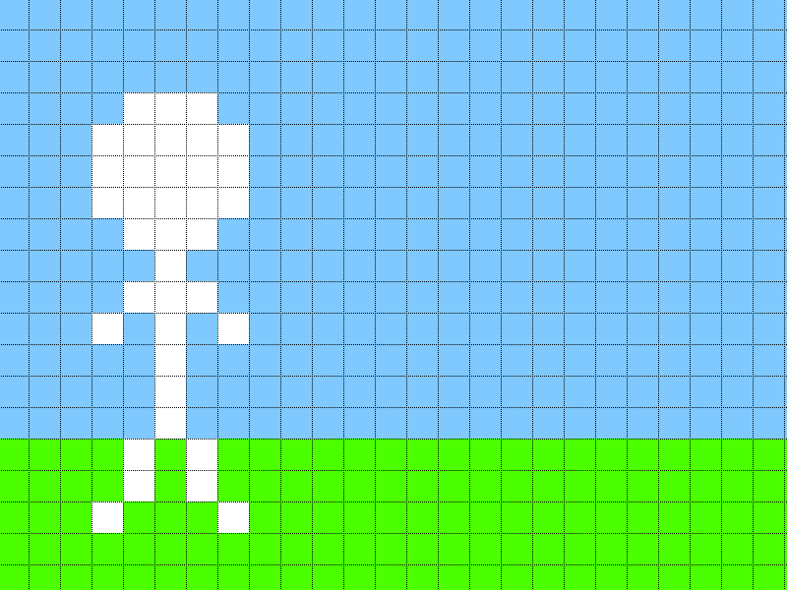
How far should I move?
Move 10 pixels to the right.
Notes:
This is actually what a computer screen looks like if you zoom in enough. The squares are called pixels.

Slide 7
Location = 20
If LEFT ARROW KEY
Then Location – 10
If RIGHT ARROW KEY
Then Location + 10
Draw Player at Location
Computer Code (instructions for the computer)
Notes:
You want the computer to remember where the player is, so you can tell it

Slide 8
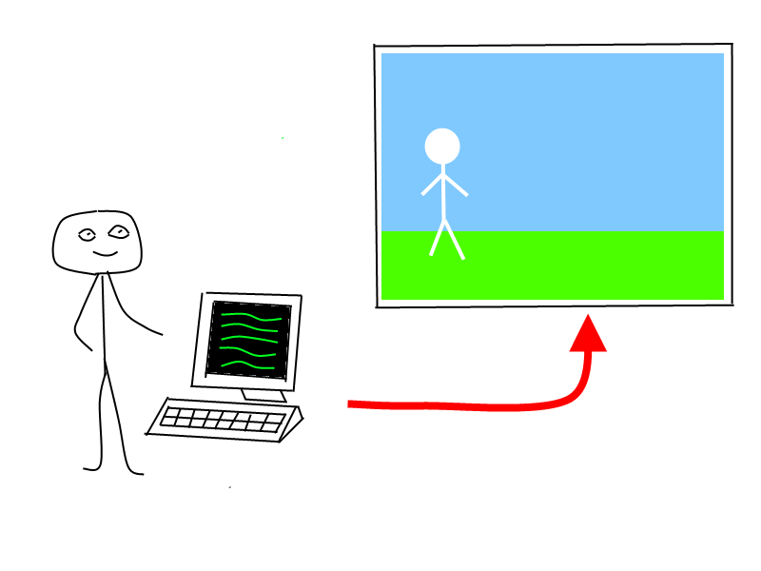
You will all be able to make your own games..

